Slide 1
Cladogram
By: Chloe Obert, Joaquin Arellanes, Gordy Brodeur, and Suyash Krishan

Slide 2
Project Overview
For this project, we had to organize tools based on collection of traits. We had to simulate them as if they were real organisms by giving backstory to what they are and describe why they’re the way they are.

Slide 3
Storyline
tools which varied as plastic with different colors such as orange and white
evolved into metal because it was to weak to withstand predators
have the trait of the metal to face the fierce heat waves with could easily clean the tool population at the time
later on started to have a matte and shiny texture to attract a mate
they evolved to becoming solid and varied as to to having holes
which led up to having them be different for example they would be hexagons, winged circles, and unconnected circles because some of the tool needed to have different uses

Slide 4
they became more threaded and varied as non thread, round top points, large rods, small rods, and dome to burrow into the ground more efficiently
they became pointed and varied in being no point and round top to defend themselves from predators better
evolved to have the thread starting at the top and varied with delayed thread, round top, and black to burrow themselves even more
evolved more to becoming Plus Sign on Top which varied as hooks which varies in color as gold or white
final stage of the evolution of tools so far was round tops which could vary as flat top with variety of colors such as gold, grey, and blue for camouflage

Slide 5
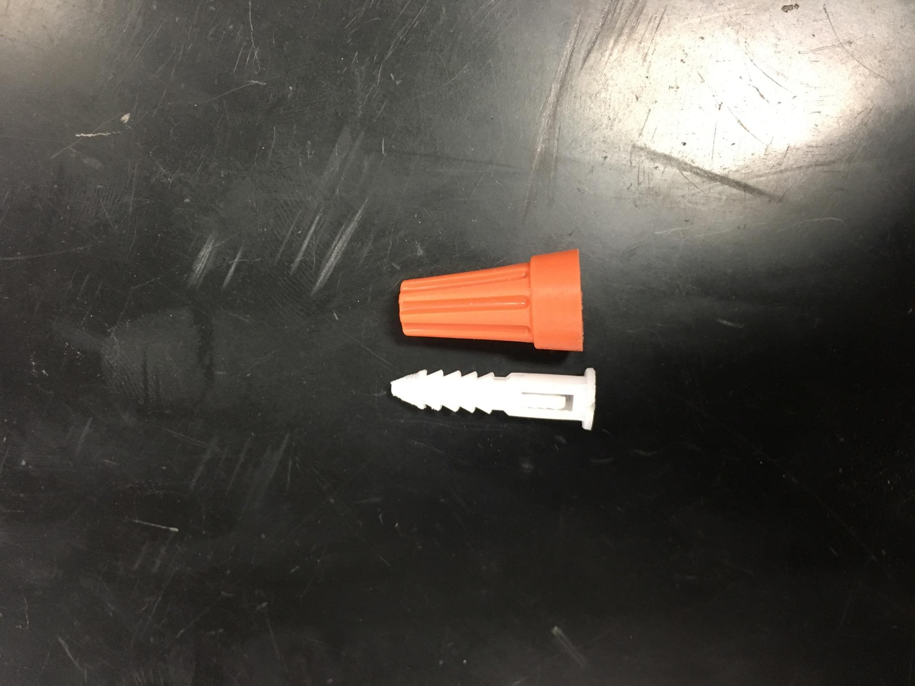
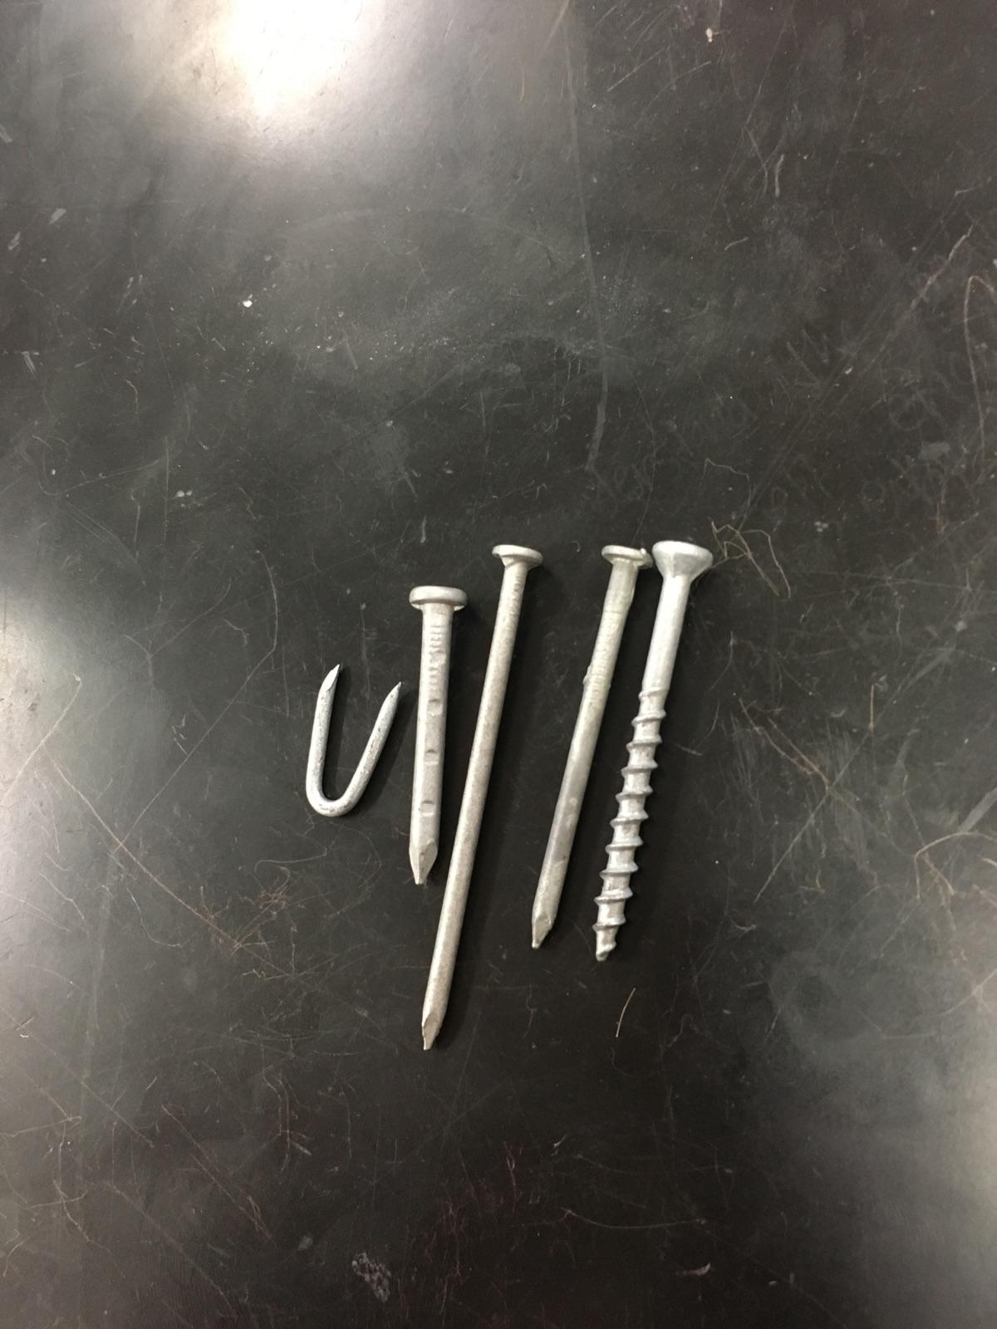
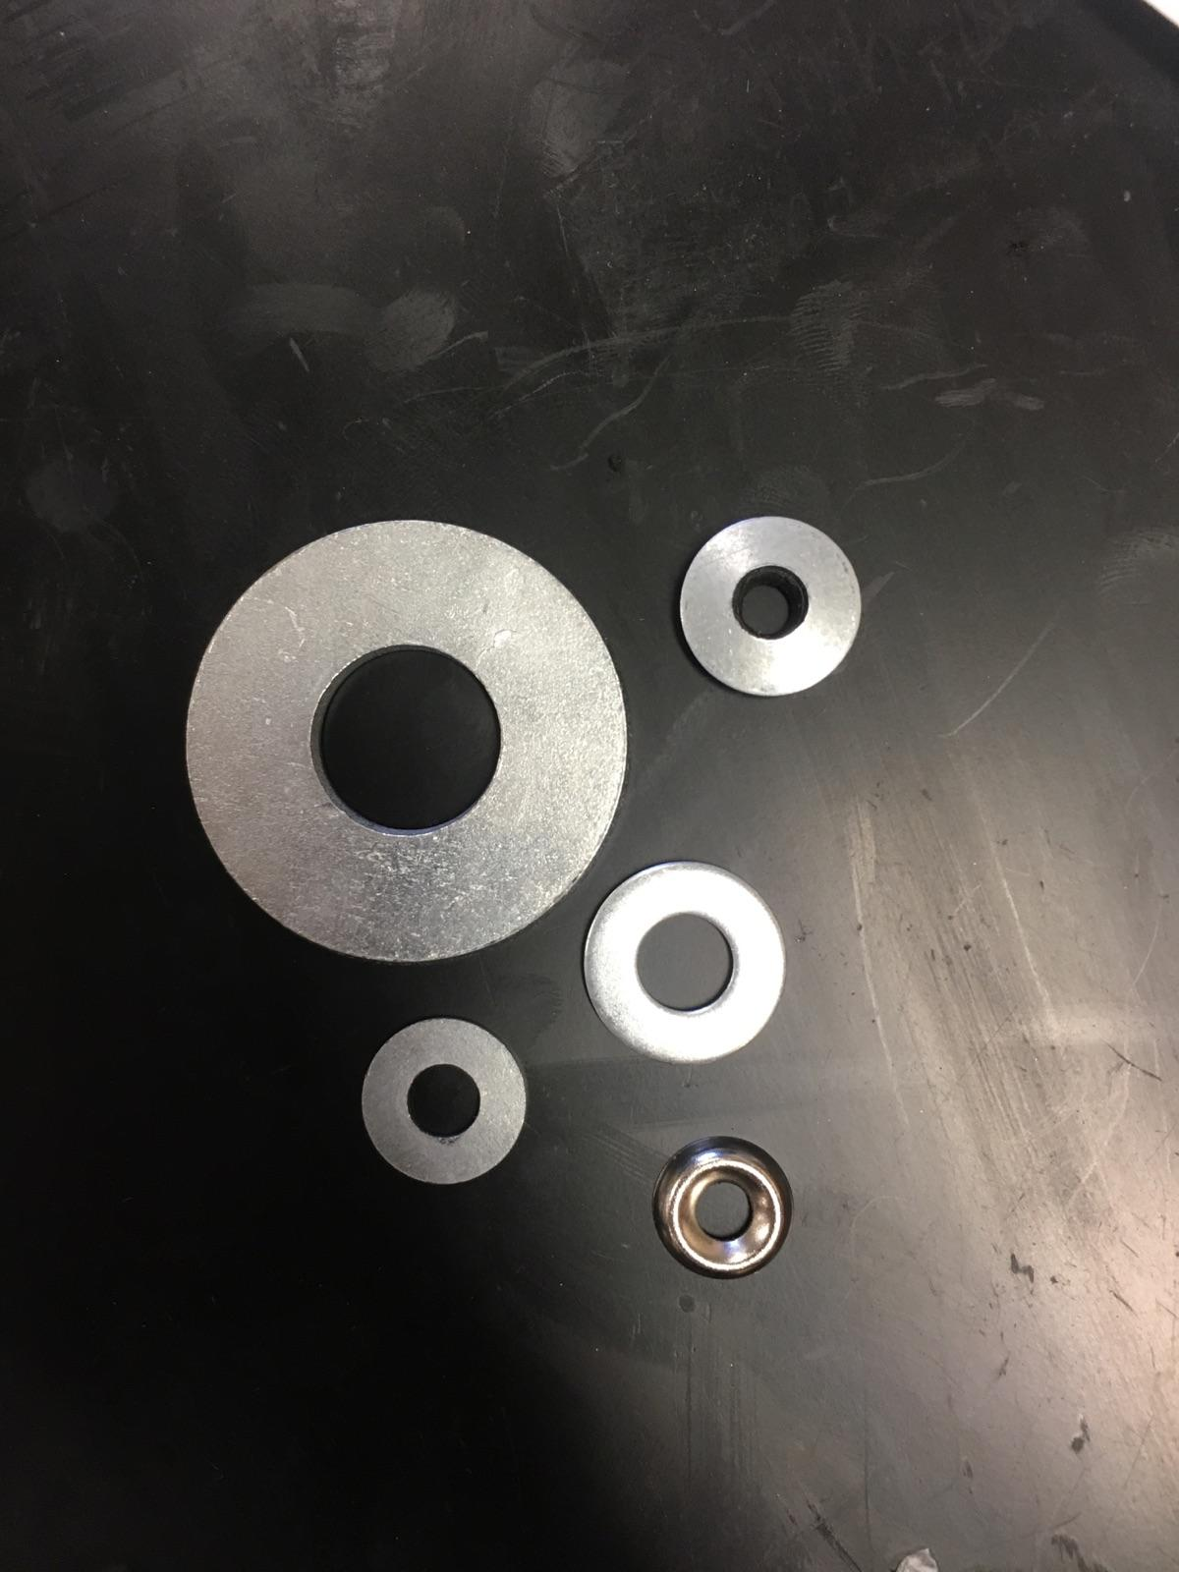
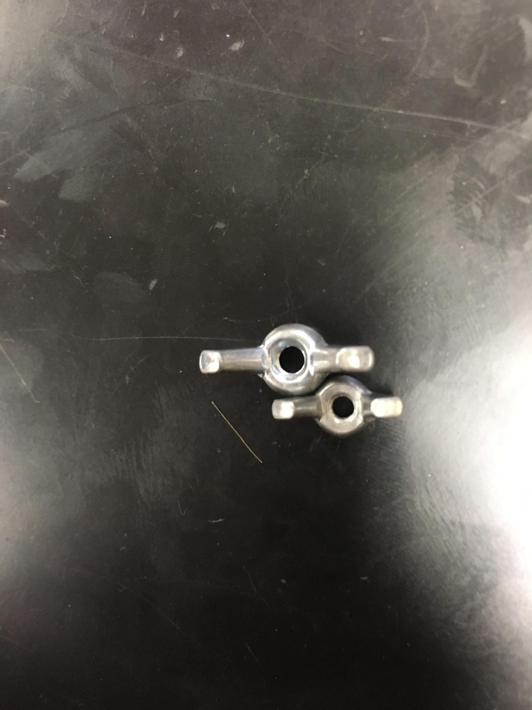
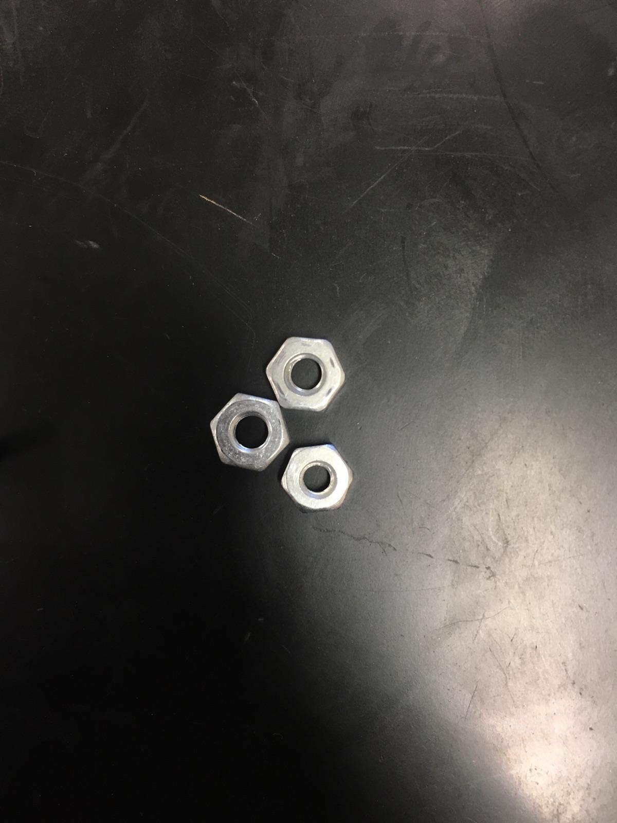
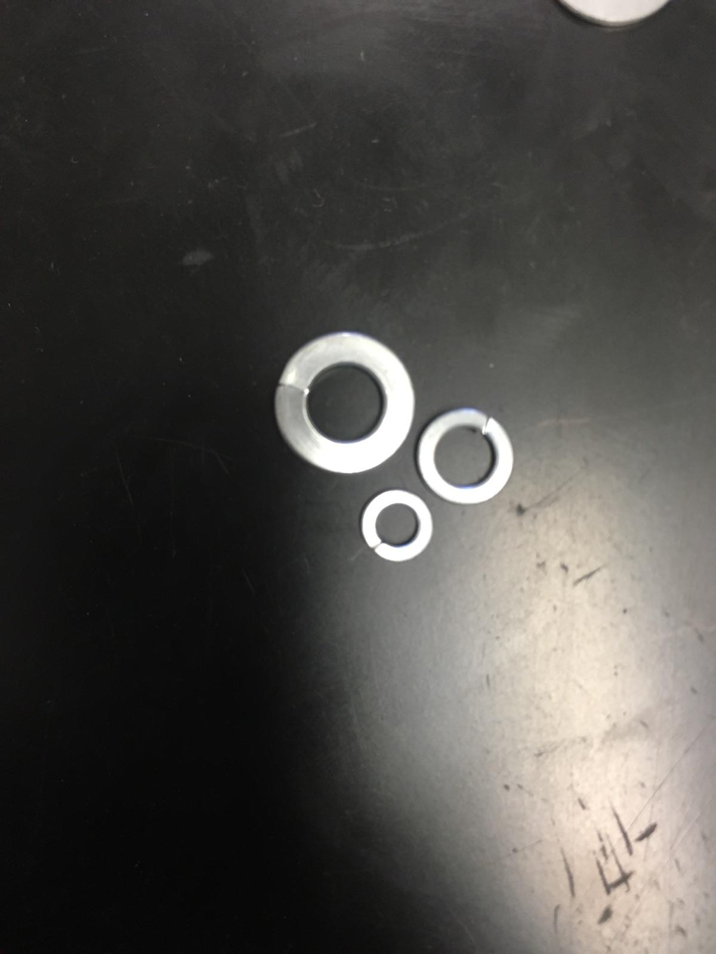
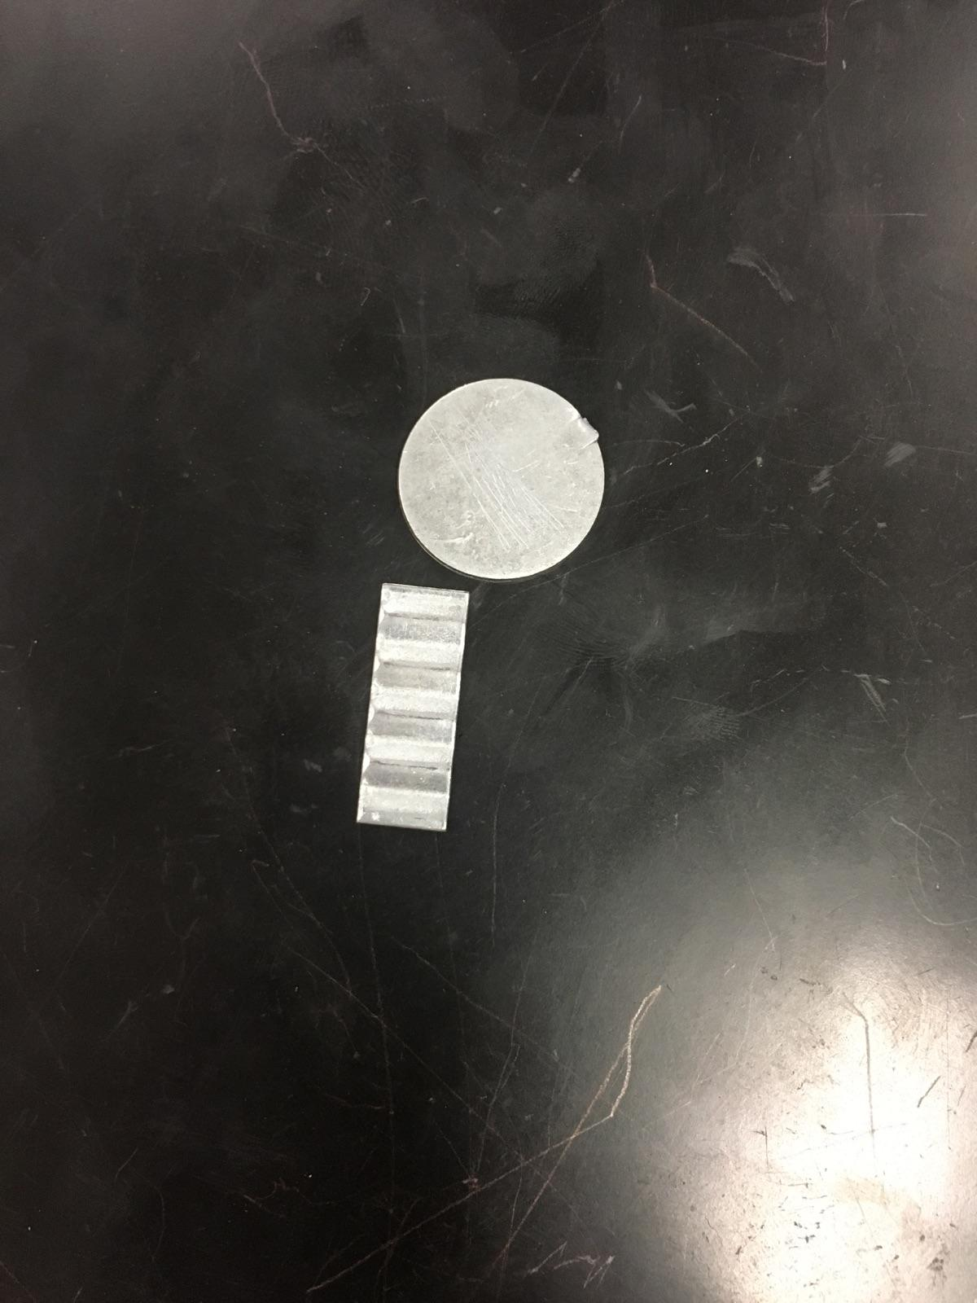
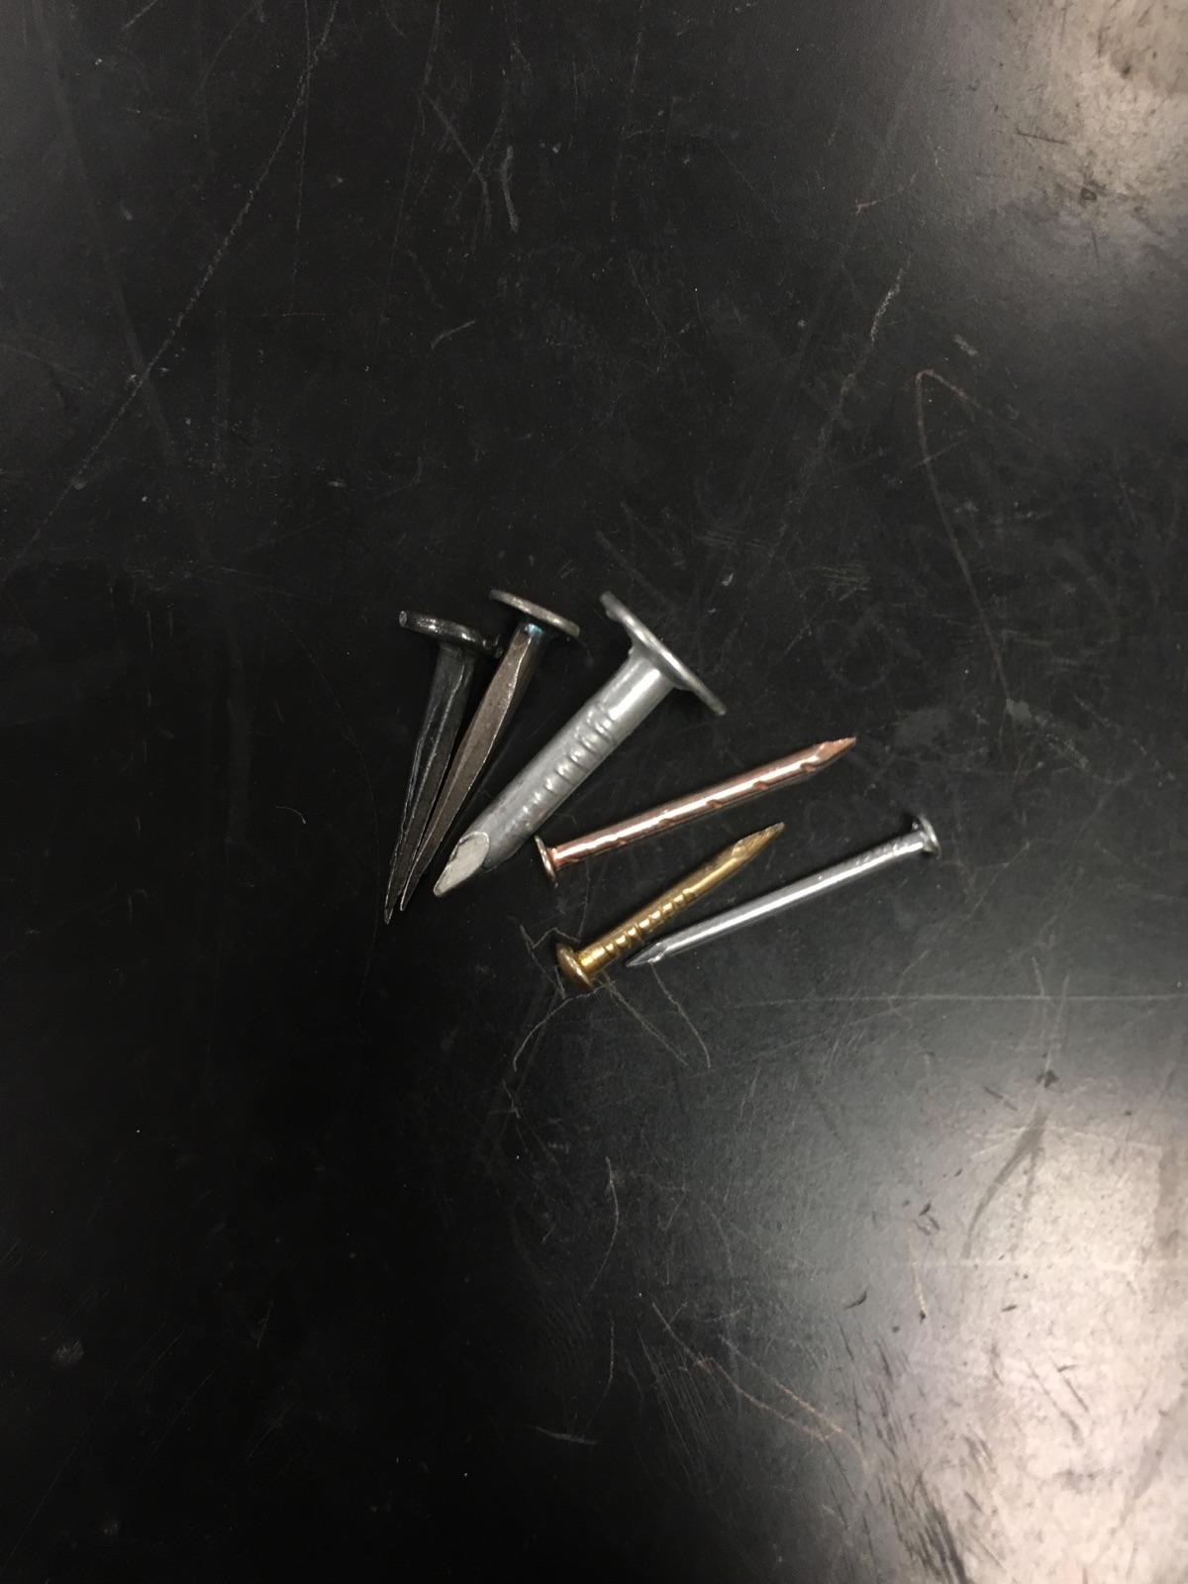
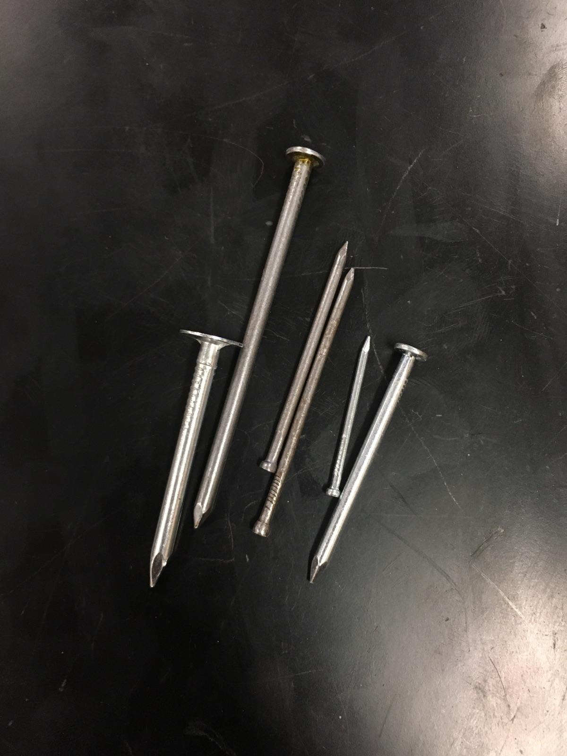
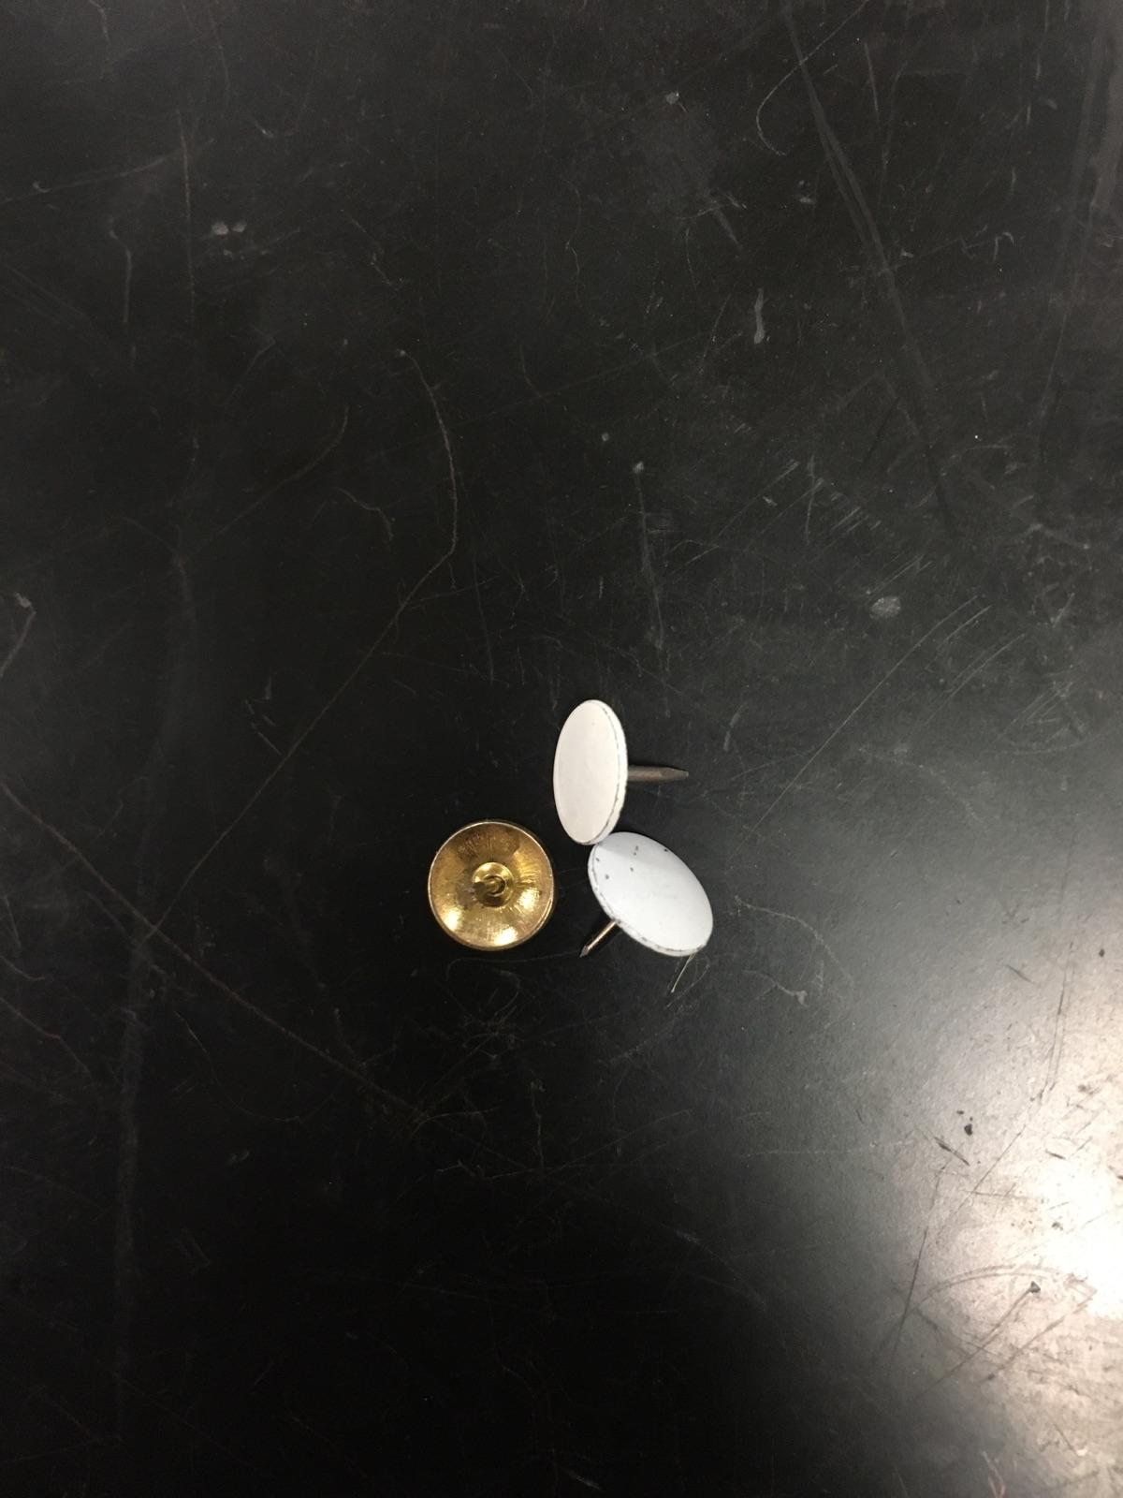
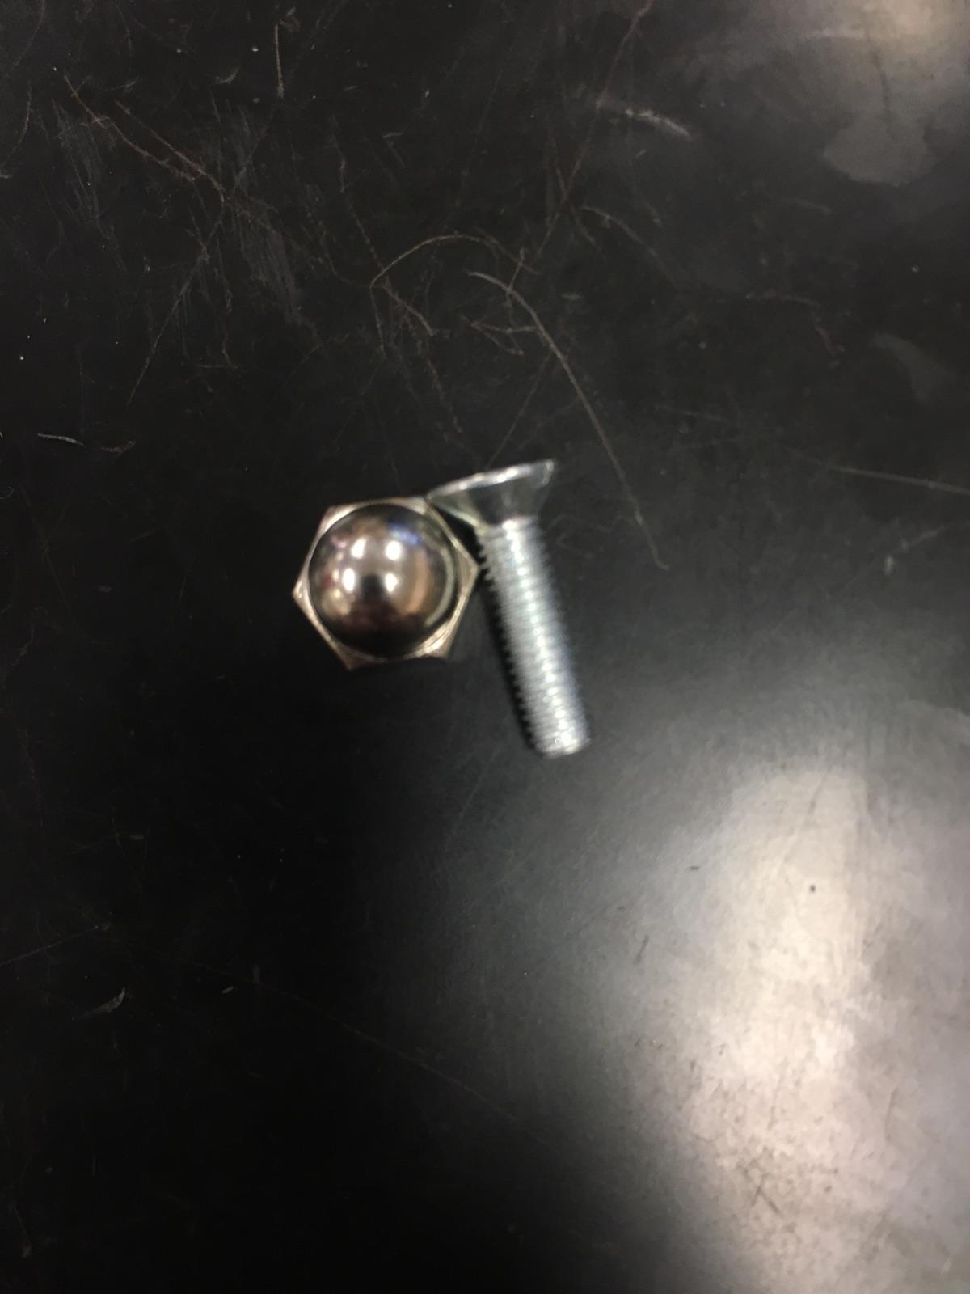
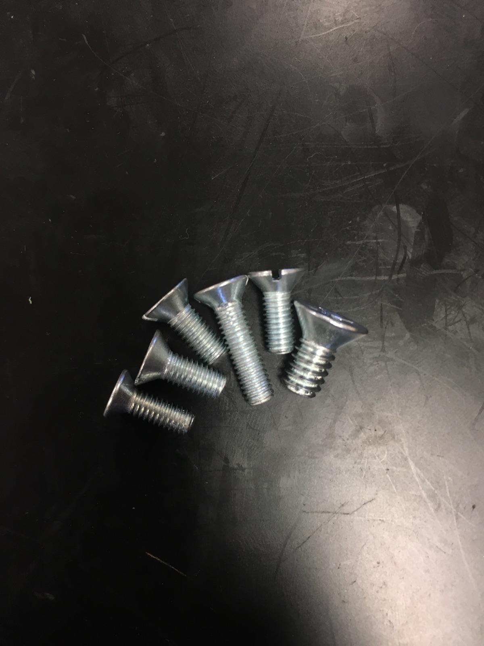
Evolution Order

Slide 6
